Slide 1
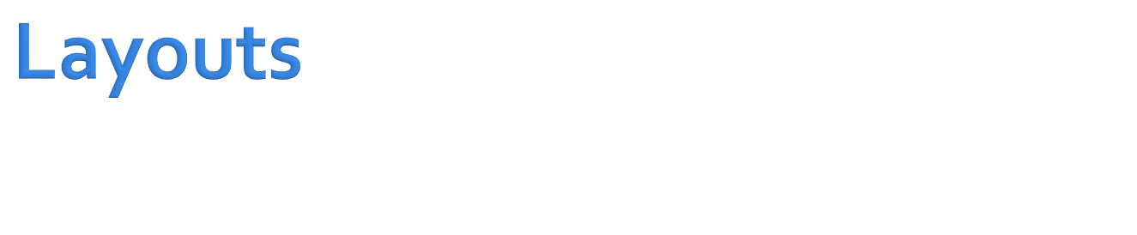

Slide 2

The basic building block for user interface components
Occupies a rectangular area on the screen
Responsible for drawing and event handling
The visual content of the window is provided by a hierarchy of views
Parent views contain and organize the layout of their children
Leaf views draw in the rectangles, control and respond to user actions directed at that space
Views are where the activity's interaction with the user takes place

Slide 3

A widget is a View object that serves as an interface for interaction with the user
Android provides a set of fully implemented widgets, like buttons, checkboxes, text-entry fields …
The developer can customized and create his own actionable elements by defining his own View objects or by extending and combining existing widgets

Slide 4

Activity's UI is defined by an hierarchy of View and ViewGroup nodes
setContentView() - attachs the view hierarchy tree to the screen for rendering

Slide 5
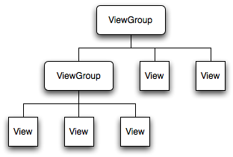

Slide 6
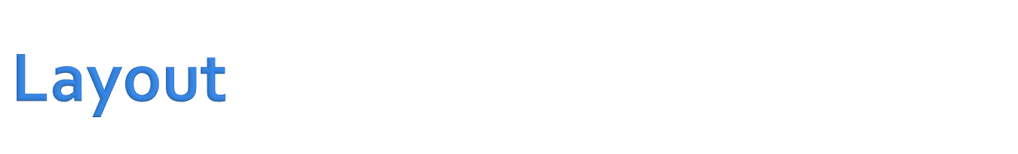
Layout is the architecture for the user interface in an Activity
Defines the layout structure and holds all the elements that appear to the user
express the view hierarchy
layout is declared in two ways:
  Declare UI elements in XML
  Instantiate layout elements at runtime
Each element in XML is either a View or ViewGroup object
View objects are leaves in the tree
ViewGroup objects are branches in the tree
The name of an XML element is respective to the Java class that it represents

Slide 7

better separate the presentation of your application from the code that controls its behavior
can modify or adapt it without having to modify your source code and recompile
  create XML layouts for different screen orientations
  create XML layouts for different device screen sizes
  create XML layouts for different languages
makes it easier to visualize the structure of your UI
easier to debug problems

Slide 8
<?xml version="1.0" encoding="utf-8"?>
<LinearLayout xmlns:android="…"
android:layout_width="fill_parent"
android:layout_height="fill_parent"
android:orientation="vertical" >
<TextView android:id="@+id/text"
android:layout_width="wrap_content"
android:layout_height="wrap_content"
android:text="Hello, I am a TextView" />
<Button android:id="@+id/button"
android:layout_width="wrap_content"
android:layout_height="wrap_content"
android:text="Hello, I am a Button" />
</LinearLayout>

Slide 9

The XML layout file is compiled into a View resource
The layout resource is loaded in the Activity.onCreate() method
The layout resource is loaded by calling setContentView() and passing the reference to the layout resource
the layout resource reference is R.layout.layout_file_name

Slide 10
public void onCreate(Bundle savedInstanceState) {
super.onCreate(savedInstanceState);
setContentView.(R.layout.main_layout);
}

Slide 11

Every View and ViewGroup object supports their own variety of XML attributes
Some attributes are specific to a View object , these attributes are inherited by any View objects that extend this class
Some attributes are common to all View objects, because they are inherited from the root View class
Other attributes are considered "layout parameters" that describe certain layout orientations of the View object

Slide 12

Any View object may have an integer ID
uniquely identify the View within the tree
the ID is typically assigned in the layout XML file as a string
This attribute is common to all View objects
android:id="@+id/my_button"

Slide 13

The syntax for an ID, inside an XML tag is:
android:id="@+id/my_button"
Referencing an Android resource ID:
android:id="@android:id/my_button"
In the layout.xml file:
<Button android:id="@+id/my_button" android:layout_width="wrap_content" android:layout_height="wrap_content" android:text="@string/my_button_text"/>
In the java code:
Button myButton = (Button) findViewById(R.id.my_button);
Notes:
Defining IDs for view objects is important when creating a RelativeLayout. In a relative layout, sibling views can define their layout relative to another sibling view, which is referenced by the unique ID.

Slide 14

Set properties: for example setting the text of a TextView. properties that are known at build time can be set in the XML layout files.
Set focus: The framework will handled moving focus in response to user input. To force focus to a specific view, call requestFocus().
Set up listeners: Views allow clients to set listeners that will be notified when something interesting happens to the view. Such as notified when the view gains or loses focus.
Set visibility: You can hide or show views using setVisibility(int).

Slide 15

View geometry is that of a rectangle
View location expressed as a pair of left and top coordinates and two dimensions, expressed as a width and a height
The unit for location and dimensions is the pixel
retrieve the location:
  getLeft()
  getTop()
  getRight()
  getBottom()

Slide 16

expressed with a width and a height
possess two pairs of width and height values:
  How big a view wants to be within its parent: measured width & height
  The actual size of the view on screen: width and height
measured width and measured height

Slide 17

Text View
Edit Text
Auto Complete Text View
Multi auto Complete text View

Slide 18

Extends View
Displays text to the user and optionally allows them to edit it
TextView is a complete text editor, however the basic class is configured to not allow editing
android.text.util.Linkify
Notes:
you can pass a TextView to the Linkify class to find and add links to the content
of the TextView. In our example, we call the addLinks() method of Linkify, passing the
TextView and a mask indicating what types of links that Linkify should look for. Linkify can
create links for text that looks like a phone number, an e-mail address, a web URL, or a map
address. Passing Linkify.ALL tells the class to “linkify” all of these link types. Clicking a link
will cause the default intent to be called for that action. For example, clicking a web URL will
launch the browser with the URL.

Slide 19

TextView tv =(TextView)
this.findViewById(R.id.cctvex);
tv.setText(“Testing");
Linkify.addLinks(tv, Linkify.ALL);

Slide 20

Extends TextView
EditText is a thin veneer over TextView that configures itself to be editable
Properties:
  capitalize to have the control capitalize words, the beginning of sentences
  phoneNumber property if you need to accept a phone number
  password property if you need a password field
  single line by setting the singleLine property to true

Slide 21

TextView with auto-complete functionality. the control display suggestions for the user to select
AutoCompleteTextView actv = (AutoCompleteTextView) this.findViewById(R.id.ccactv);
ArrayAdapter<String> aa = new ArrayAdapter<String>(this,
android.R.layout.simple_dropdown_item_1line,
new String[] {"English", "Hebrew", "Hindi", "Spanish", "German","Greek" });
actv.setAdapter(aa);

Slide 22

Simple Button
Image Button
Toggle Button
Check Box
Radio Button

Slide 23

Button represents a push-button widget
Extends TextView
Push-buttons can be pressed, or clicked, by the user to perform an action
A typical use of a push-button in an activity would be the following:
final Button button = (Button) findViewById(R.id.button_id);
button.setOnClickListener(new View.OnClickListener() {
public void onClick(View v) { // Perform action on click } });

Slide 24

<Button android:id="@+id/ccbtn1"
android:text="@+string/basicBtnLabel"
android:typeface="serif" android:textStyle="bold"
android:layout_width="fill_parent"
android:layout_height="wrap_content" />

Slide 25

<ImageButton android:id="@+id/imageBtn" android:src="@drawable/btnImage"
android:layout_width="wrap_content"
android:layout_height="wrap_content"/>
ImageButton btn = (ImageButton)this.findViewById(R.id.imageBtn);
btn.setImageResource(R.drawable.icon);

Slide 26

Two-state button
This button can be in either the On state or the Off state
<ToggleButton android:id="@+id/cctglBtn"
android:layout_width="wrap_content"
android:layout_height="wrap_content"
android:textOn="Run"
android:textOff="Stop"
android:text="Toggle Button"/>

Slide 27

Two-state button that allows the user to toggle its state
  setChecked()
  toggle()
  isChecked()
  setOnCheckedChangeListener()
    onCheckedChanged()
<CheckBox android:text=“CheckBox"
android:layout_width="wrap_content" android:layout_height="wrap_content" />

Slide 28

First create a RadioGroup and then populate the group with radio buttons
<RadioGroup
android:layout_width="wrap_content"
android:layout_height="wrap_content">
<RadioButton android:id="@+id/chRBtn"
android:text="Chicken"
<RadioButton android:id="@+id/fishRBtn" android:text="Fish"
</RadioGroup>

Slide 29
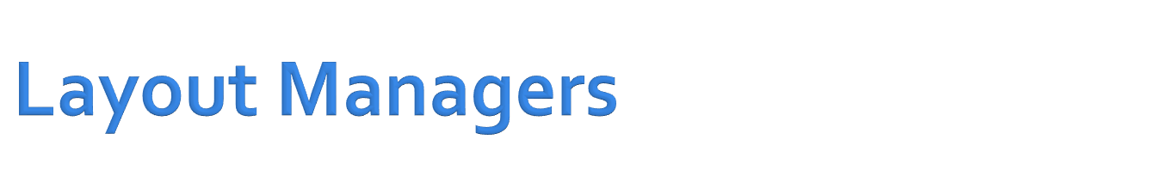
containers for views
manage the size and position of its children
  LinearLayout Organizes horizontally or vertically.
  TableLayout Organizes in tabular form
  RelativeLayout Organizes its children relative to one another or to the parent
  AbsoluteLayout Positions based on exact coordinates
  FrameLayout Allows to dynamically change the control(s) in the layout

Slide 30

manager organizes its children either horizontally or vertically based on the value of the orientation property
<LinearLayout xmlns:android=“…"
android:orientation="horizontal"
android:layout_width="fill_parent"
android:layout_height="wrap_content">
<!-- add children here-->
</LinearLayout>

Slide 31

Android:gravity is a setting used by the view
Android:layout_gravity is used by the container

Slide 32

You could specify the dimensions in any of the following units:
  px: Pixels
  in: Inches
  mm: Millimeters
  pt: Points
  dp: Density-independent pixels based on a 160-dpi (pixel density per inch) screen (dimensions adjust to screen density)
  sp: Scale-independent pixels (dimensions that allow for user sizing; helpful for use in fonts)

Slide 33

extension of LinearLayout
This layout structures its child controls into rows and columns
<TableLayout xmlns:android=“…"
android:layout_width="fill_parent"
android:layout_height="fill_parent">
<TableRow>
<TextView … />
<EditText … />
</TableRow>
<TextView … />
<EditText … />
</TableRow>
</TableLayout>

Slide 34

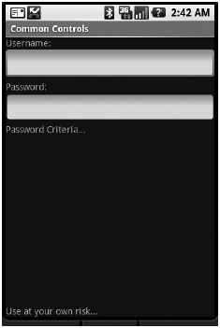
implements a policy where the controls in the container are laid out relative to either the container or another control in the container

Slide 35
<RelativeLayout xmlns:android=“…"
<TextView android:id="@+id/userNameLbl"
android:layout_alignParentTop="true" />
<EditText android:id="@+id/userNameText"
android:layout_below="@id/userNameLbl" />
<TextView android:id="@+id/pwdLbl"
android:layout_below="@id/userNameText" />
<EditText android:id="@+id/pwdText"
android:layout_below="@id/pwdLbl"/>
<TextView android:id="@+id/pwdHintLbl"
android:layout_below="@id/pwdText"/>
<TextView android:id="@+id/disclaimerLbl"
android:layout_alignParentBottom="true" />
</RelativeLayout>

Slide 36

allows you to specify the exact position for the controls in the container.
<AbsoluteLayout …>
<TextView android:text="Username:"
android:layout_x="50px"
android:layout_y="50px" />
<EditText
android:layout_x="160px"
android:layout_y="50px" />
<TextView android:text="Password:"
android:layout_x="50px"
android:layout_y="100px" />
</AbsoluteLayout>

Slide 37
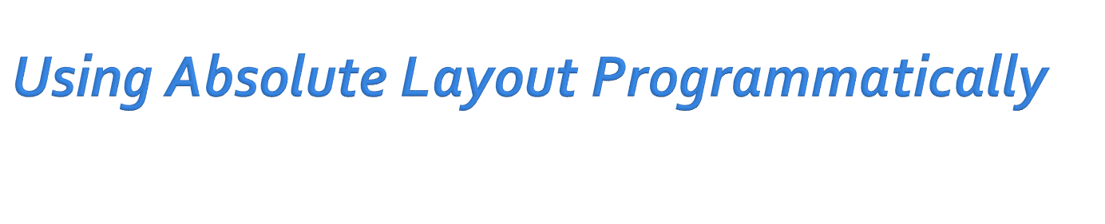
public void onCreate(Bundle icicle)
{
super.onCreate(icicle);
ImageView img = new ImageView(this);
imgsetImageResource(R.drawable.myimage);
AbsoluteLayout al = new AbsoluteLayout(this);
mContentView.addView(img,
new AbsoluteLayout.LayoutParams(
50, // width
50, //height
0, //left
0); //top
SetContentView(al);
}

Slide 38

mainly used to display a single item
You mainly use this utility layout class to dynamically display a single view
but you can populate it with many items, setting one to visible while the others are nonvisible

Slide 39
<FrameLayout …>
<ImageView …
android:id="@+id/oneImgView" android:src="@drawable/one" />
<ImageView …
android:id="@+id/twoImgView" android:src="@drawable/two"
android:visibility="gone" />
</FrameLayout>

Slide 40
@Override
protected void onCreate(Bundle savedInstanceState) {
…
setContentView(R.layout.frame);
ImageView one = (ImageView)this.findViewById(R.id.oneImgView);
ImageView two = (ImageView)this.findViewById(R.id.twoImgView);
one.setOnClickListener(new OnClickListener(){
@Override
public void onClick(View view) {
ImageView two = (ImageView)FramelayoutActivity.this.
findViewById(R.id.twoImgView);
two.setVisibility(View.VISIBLE);
view.setVisibility(View.GONE);
}});
two.setOnClickListener(new OnClickListener(){
@Override
public void onClick(View view) {
ImageView one = (ImageView)FramelayoutActivity.
this.findViewById(R.id.oneImgView);
one.setVisibility(View.VISIBLE);
view.setVisibility(View.GONE);
}});
}

Slide 41

The ListView control displays a list of items vertically
Generally use a ListView by writing a new activity that extends android.app.ListActivity
setListAdapter set the data for the ListView

Slide 42
@Override
protected void onCreate(Bundle savedInstanceState)
{
super.onCreate(savedInstanceState);
Cursor c = getContentResolver().query(People.CONTENT_URI,
null, null, null, null);
startManagingCursor(c);
String[] cols = new String[]{People.NAME};
int[] names = new int[]{R.id.row_tv};
adapter = new SimpleCursorAdapter(this,R.layout.lists,c,cols,names);
this.setListAdapter(adapter);
}
}

Slide 43

Adapters are used for binding data to a control
Adapters are employed for widgets that extend android.widget.AdapterView:
  ListView
  GridView
  Spinner
  Gallery

Slide 44

View
ViewGroup
AdapterView
ListView
GridView
Spinner
Gallery

Slide 45

It specifically targets list controls
Assumes that TextView controls represent the list items
Displays text only using to toString() of its elements

Slide 46

public ArrayAdapter (Context context, int textViewResourceId, T[] objects)
context The current context
resource The resource ID for a layout file containing a layout to use when instantiating views
textViewResourceId The id of the TextView within the layout resource to be populated
objects The objects to represent in the ListView

Slide 47
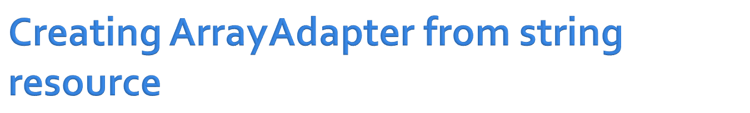
adapter = ArrayAdapter.createFromResource(this,
R.array.colors,
android.R.rowLayout);

Slide 48

<string-array name="planets">
  <item>Mercury</item>
  <item>Venus</item>
  <item>Earth</item>
  <item>Mars</item>
  <item>Jupiter</item>
  <item>Saturn</item>
  <item>Uranus</item>
  <item>Neptune</item>
  <item>Pluto</item>
</string-array>

Slide 49

Easy adapter to map static data to views defined in an XML file
You can specify the data as an ArrayList of Maps
Each entry in the ArrayList corresponds to one row in the list
The Maps contain the data for each row
You also specify an XML file that defines the views used to display the row
Define mapping from keys in the Map to specific views

Slide 50
public SimpleAdapter (Context context, List<? extends Map<String, ?>> data,
int resource, String[] from, int[] to)
Parameters
Context: The context the View associated with
Data: List of Maps. Each entry in the List corresponds to one row in the list.
Resource: view layout that defines the views for this list item.
From: A list of column names
To: The views that should display column in the "from" parameter.

Slide 51

displays items in a two-dimensional, scrolling grid.
The items are acquired from a ListAdapter.

Slide 52
private class ItemsAdapter extends ArrayAdapter<Item> {
private Item[] items;
public ItemsAdapter(Context context, int textViewResourceId, Item[] items) {
super(context, textViewResourceId, items);
this.items = items;
}
@Override
public View getView(int position, View convertView, ViewGroup parent) {
View v = convertView;
if (v == null) {
LayoutInflater vi = (LayoutInflater)getSystemService (Context.LAYOUT_INFLATER_SERVICE);
v = vi.inflate(R.layout.items_list_item, null);
}
Item it = items[position];
if (it != null) {
ImageView iv = (ImageView) v.findViewById(R.id.list_item_image);
if (iv != null) {
iv.setImageDrawable(it.getImage());
}
}
return v;
}
}

